Slide 1



IOB CYBERNOVA HACKATHON 2025
Problem Statement Title - Secured Voice Authentication
Theme- AI Powered Voice Auth for Enhanced Security
PS Category- Software
Team ID- 09
-
Team Name (Registered on portal)- True Sight
Name of the Members and College Regn No
Syed Thufel Syed Wahid (230171601189)
Vishwanathan.M (230171601196)
Sabilah.S (230171601159) &
Nizamutheen (230171601153)
Mentor – Mrs.Amsavalli S, Assitant Professor

Slide 2
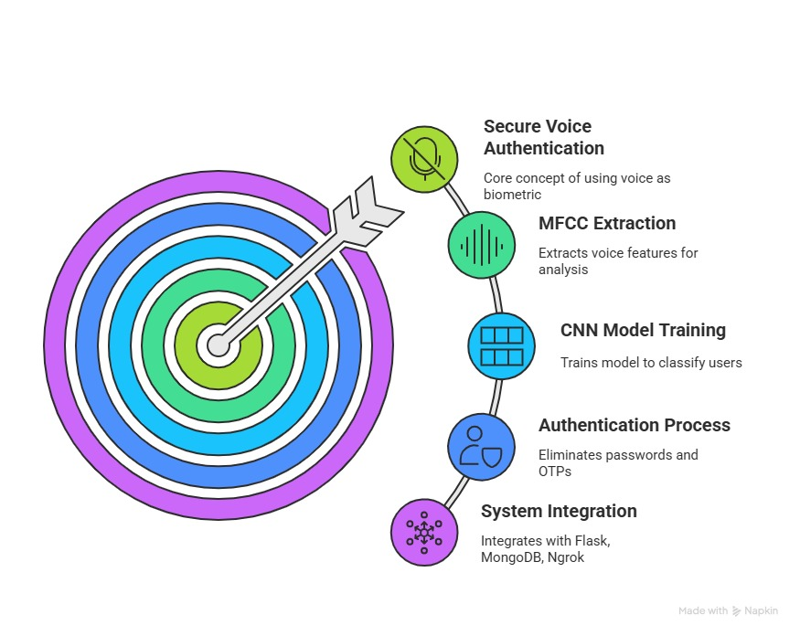
VOICE AUTHENTICATION SYSTEM
TEAM 9 : TRUE SIGHT

Slide 3
FEASIBILITY AND VIABILITY
Feasibility
Runs efficiently on lightweight infrastructure.
Mic-Only Access: Works on any device with a microphone—no need for smartphones or advanced tech.
No Reading or Typing: Users simply speak a verification code to authenticate.
Language & Literacy Friendly: Accessible to all users, regardless of language or literacy level.
Challenges & Risks
Audio Variability: Noise and mic quality can affect accuracy.
Cold Start: Limited data at launch may reduce performance.
Already existing authentication method in Banking System.
Mitigation Strategies
Use of CNN model instead of existing DNN model provides more accuracy than existing banking voice authentication model.
Audio Preprocessing: Normalization and bandpass filtering for cleaner input.
Strong Base Model: Trained on 197k+ voice samples from Kaggle.
Ongoing Learning: CNN model updates with each new user.
Consistent Input: MFCCs are padded/resized for uniformity.
Verification Code: Spoken code removes language and literacy barriers.
TEAM 9 : TRUE SIGHT

Slide 4
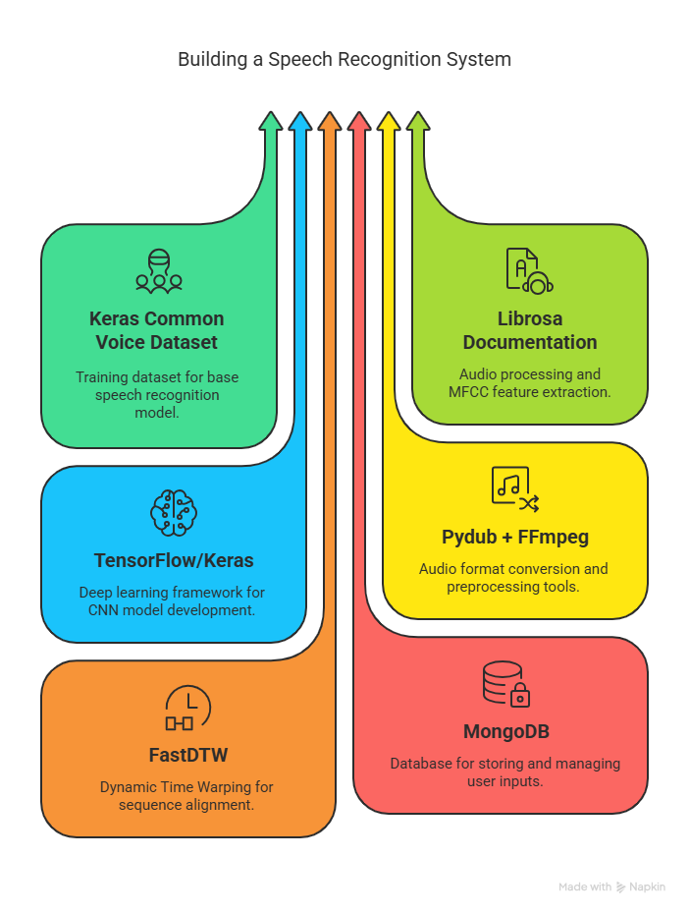
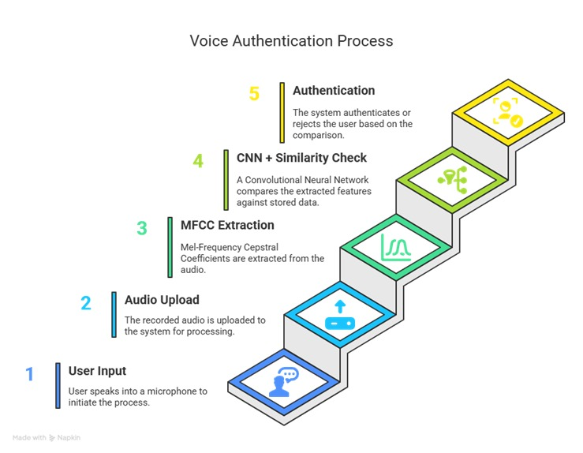
TECHNICAL APPROACH
TEAM 9 : TRUE SIGHT

Slide 5
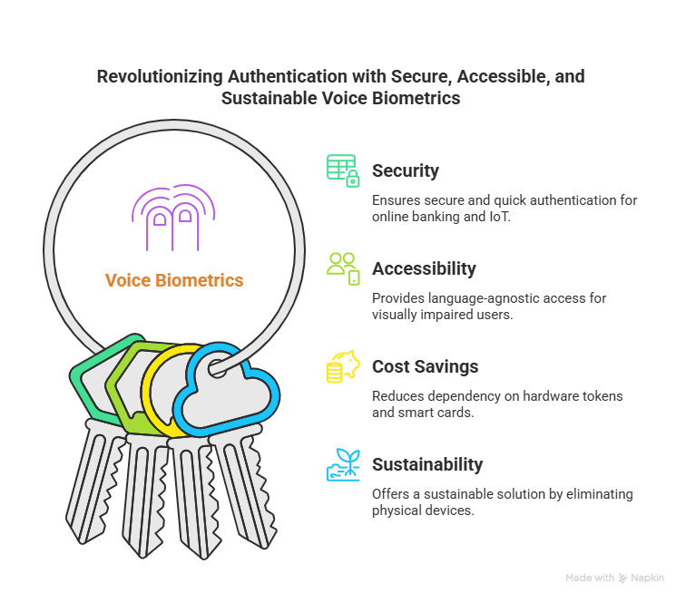


IMPACT AND BENEFITS
Using the verification code for voice recording enhances accessibility by removing language barriers during authentication
TEAM 9 : TRUE SIGHT

Slide 6
RESEARCH AND REFERENCES
Reference Link:
https://www.researchgate.net/publication/324031666_Voice_Biometric_A_Technology_for_Voice_Based_Authentication
https://www.researchgate.net/publication/361217651_Use_of_AI_Voice_Authentication_Technology_Instead_of_Traditional_Keypads_in_Security_Devices
https://www.researchgate.net/publication/379489115_Implementation_of_Voice_Biometric_System_in_the_Banking_Sector
https://pmc.ncbi.nlm.nih.gov/articles/PMC6425070/
TEAM 9 : TRUE SIGHT

